Slide 1

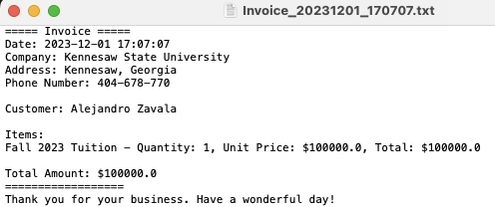

Invoice Generator by Alejandro Zavala
This project is to create a program that can create invoices for companies after making a sale. Such as in the screenshot beside.

